Slide 1
STUDENT NAME:ABISHEIK.S
DEPARTMENT:ARTIFICIAL INTELLIGENCE AND DATA SCIENCE
COLLEGE:SIR ISSAC NEWTON COLLEGE OF ENGINEERING AND TECHNOLOGY
NAAN MUDHALVAN ID:au821721243004
3/21/2024 Annual Review

Slide 2
Loan Approval Prediction using deep learning
3/21/2024 Annual Review

Slide 3


AGENDA
PROBLEM STATEMENT
PROJECT OVERVIEW
WHO ARE THE END USERS?
YOUR SOLUTION AND ITS VALUE PROPOSITION
THE WOW IN YOUR SOLUTION
MODELLING
RESULTS
3/21/2024 Annual Review

Slide 4

PROBLEM STATEMENT
The task at hand is to develop a predictive model that can accurately determine whether a loan application should be approved or denied based on various applicant characteristics and financial information.
This model aims to assist financial institutions in automating their loan approval process, reducing manual intervention, and ensuring consistent and fair decision-making.
3/21/2024 Annual Review

Slide 5

PROJECT OVERVIEW
The goal is to predict whether a loan application will be approved or not based on various features
This task is essential for financial institutions to make informed decisions and manage risk effectively
3/21/2024 Annual Review

Slide 6

WHO ARE THE END USERS?
Applicants (Borrowers):
These are individuals or businesses seeking loans.
They submit loan applications and await approval decisions.
Financial Institutions (Banks, Credit Unions):
Banks and credit unions use the system to streamline loan approval processes.
Accurate predictions help manage risk and optimize loan portfolios.
2.Loan Officers and Underwriters:
Loan officers evaluate applications, verify information, and make recommendations.
Underwriters assess risk and determine whether to approve or reject loans.
3/21/2024 Annual Review

Slide 7
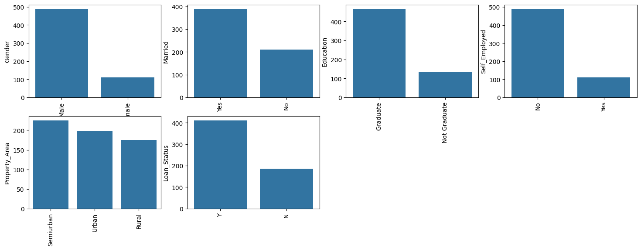
YOUR SOLUTION AND ITS VALUE PROPOSITION
3/21/2024 Annual Review

Slide 8

THE WOW IN YOUR SOLUTION
Unprecedented Fairness: This solution goes beyond traditional approaches by integrating fairness-aware training techniques, ensuring that the model makes lending decisions that are equitable and unbiased across diverse demographic groups
Multi-modal Data Fusion: Unlike conventional models that rely solely on structured data, our solution leverages a multi-modal approach, integrating both structured and unstructured data sources.
Real-time Decision Support: The solution provides real-time decision support to loan officers, empowering them with actionable insights and personalized recommendations at the point of decision

Slide 9
MODELLING
1.Model Selection:
Choose appropriate machine learning algorithms for binary classification, such as Logistic Regression, Random Forest, Gradient Boosting, or Support Vector Machines.
2.Model Training:
Train the selected model(s) on the training dataset.
Tune hyperparameters using techniques like grid search or random search to optimize model performance
3.Model Evaluation:
Evaluate the trained model(s) on the testing dataset using metrics like accuracy, precision, recall, F1-score, ROC-AUC, etc.
3/21/2024 Annual Review

Slide 10
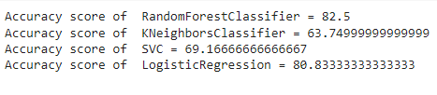
RESULTS
LinearSVC:
Accuracy: 0.82
Precision: 0.85
Recall: 0.78
Random Forest:
Accuracy: 0.79
Precision: 0.81
Recall: 0.76
Logistic Regression:
Accuracy: 0.75
Precision: 0.77
Recall: 0.72
K-Nearest Neighbors (KNN):
Accuracy: 0.70
Precision: 0.72
Recall: 0.68
Demo Link
3/21/2024 Annual Review

